Slide 1
UMass Lowell Computer Science 91.404
Analysis of Algorithms
Prof. Karen Daniels
Spring, 2008
Design Patterns
for
Optimization Problems
Dynamic Programming & Greedy Algorithms

Slide 2
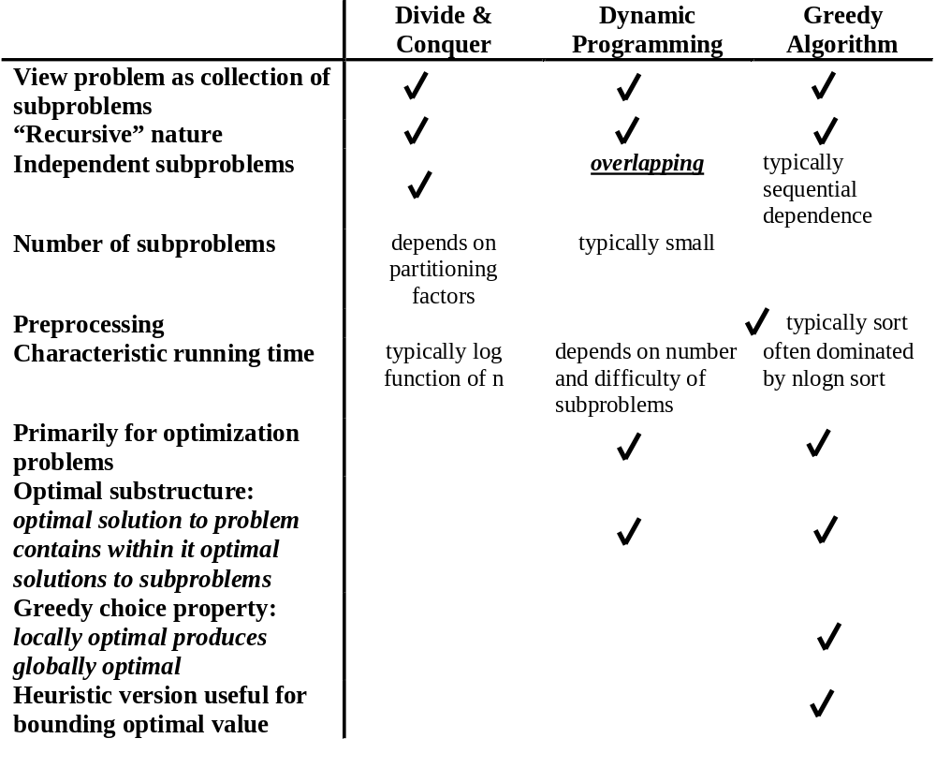
Algorithmic Paradigm Context
Solve subproblem(s), then make choice
Make choice, then solve subproblem(s)
Subproblem solution order

Slide 3
Dynamic Programming Approach to Optimization Problems
Characterize structure of an optimal solution.
Recursively define value of an optimal solution.
Compute value of an optimal solution in bottom-up fashion.
Construct an optimal solution from computed information.
source: 91.503 textbook Cormen, et al.

Slide 4
Dynamic Programming
Longest Common Subsequence
Notes:
I joined the UMass Lowell Computer Science faculty this summer. This collection of slides is intended to familiarize the reader/viewer with my field of research (Computational Geometry), summarize my previous research results in this field and outline my plan for Computational Geometry research at UMass Lowell.

Slide 5
Example: Longest Common Subsequence (LCS): Motivation
Strand of DNA: string over finite set {A,C,G,T}
  each element of set is a base: adenine, guanine, cytosine or thymine
Compare DNA similarities
S₁ = ACCGGTCGAGTGCGCGGAAGCCGGCCGAA
S₂ = GTCGTTCGGAATGCCGTTGCTCTGTAAA
One measure of similarity:
  find the longest string S₃ containing bases that also appear (not necessarily consecutively) in S₁ and S₂
  S₃ = GTCGTCGGAAGCCGGCCGAA
source: 91.503 textbook Cormen, et al.

Slide 6










Example: LCS
Definitions
source: 91.503 textbook Cormen, et al.
Sequence is a subsequence of if (strictly increasing indices of X) such that
  example: is subsequence of with index sequence
Z is common subsequence of X and Y if Z is subsequence of both X and Y
  example:
    common subsequence but not longest
    common subsequence. Longest?
Longest Common Subsequence Problem: Given 2 sequences X, Y, find maximum-length common subsequence Z.

Slide 7







Example: LCS
Step 1: Characterize an LCS
THM 15.1: Optimal LCS Substructure
Given sequences:
For any LCS of X and Y:
1 if then and Z_{k-1} is an LCS of X_{m-1} and Y_{n-1}
2 if then Z is an LCS of X_{m-1} and Y
3 if then Z is an LCS of X and Y_{n-1}
PROOF: based on producing contradictions
1 a) Suppose . Appending to Z contradicts longest nature of Z.
b) To establish longest nature of Z_{k-1}, suppose common subsequence W of X_{m-1} and Y_{n-1} has length > k-1. Appending to W yields common subsequence of length > k = contradiction.
2 Common subsequence W of X_{m-1} and Y of length > k would also be common subsequence of X_{m}, Y, contradicting longest nature of Z.
3 Similar to proof of (2)
source: 91.503 textbook Cormen, et al.

Slide 8
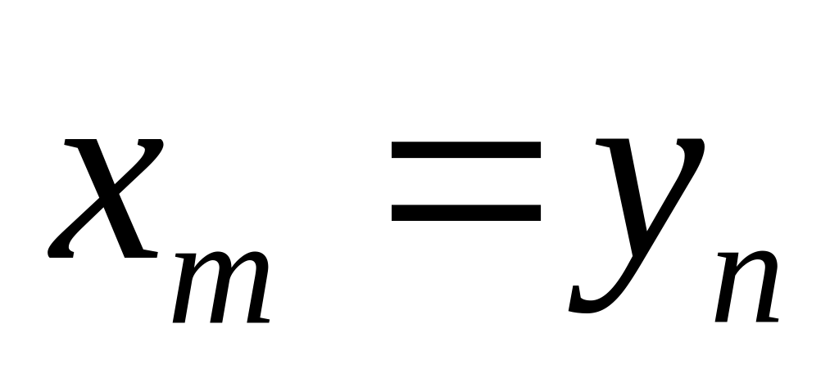
Example: LCS
Step 2: A Recursive Solution
Implications of Theorem 15.1:
yes
?
no
Find LCS(X_{m-1}, Y_{n-1})
Find LCS(X_{m-1}, Y)
Find LCS(X, Y_{n-1})
LCS₁(X, Y) = LCS(X_{m-1}, Y_{n-1}) + x_{m}
LCS₂(X, Y) = max(LCS(X_{m-1}, Y), LCS(X, Y_{n-1}))

Slide 9



Example: LCS
Step 2: A Recursive Solution (continued)
source: 91.503 textbook Cormen, et al.
Overlapping subproblem structure:
Recurrence for length of optimal solution:
Θ(mn) distinct subproblems
0 if i=0 or j=0
c[i,j]= c[i-1,j-1]+1 if i,j > 0 and x_{i}=y_{j}
max(c[i,j-1], c[i-1,j]) if i,j > 0 and x_{i}=y_{j}
Conditions of problem can exclude some subproblems!

Slide 10
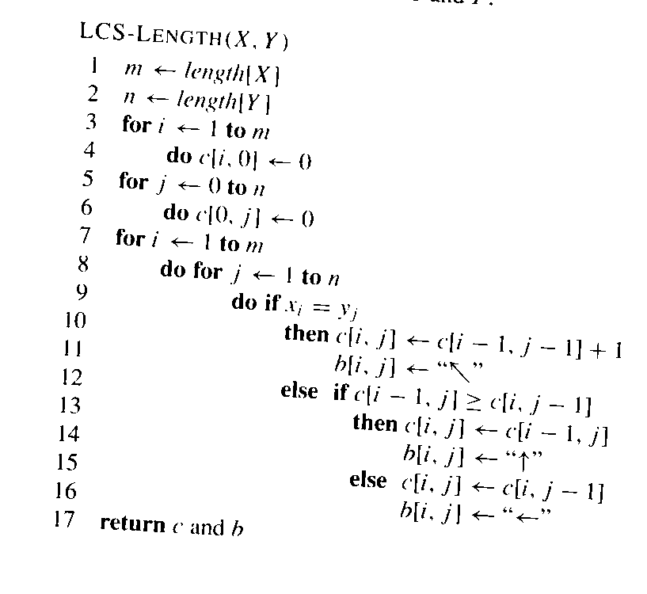
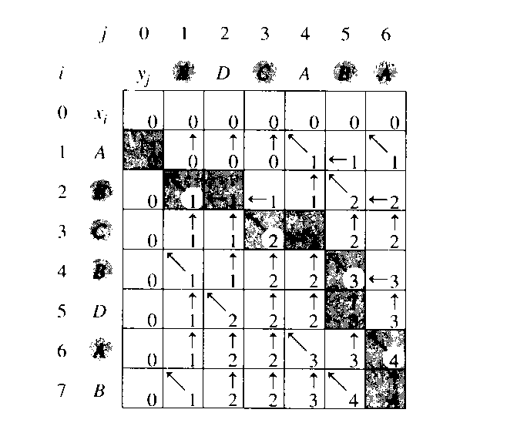
Example: LCS
Step 3: Compute Length of an LCS
What is the asymptotic worst-case time complexity?
B
C
B
A
0
B
1
C
2
B
3
A
4
c table
(represent b table)
source: 91.503 textbook Cormen, et al.

Slide 11
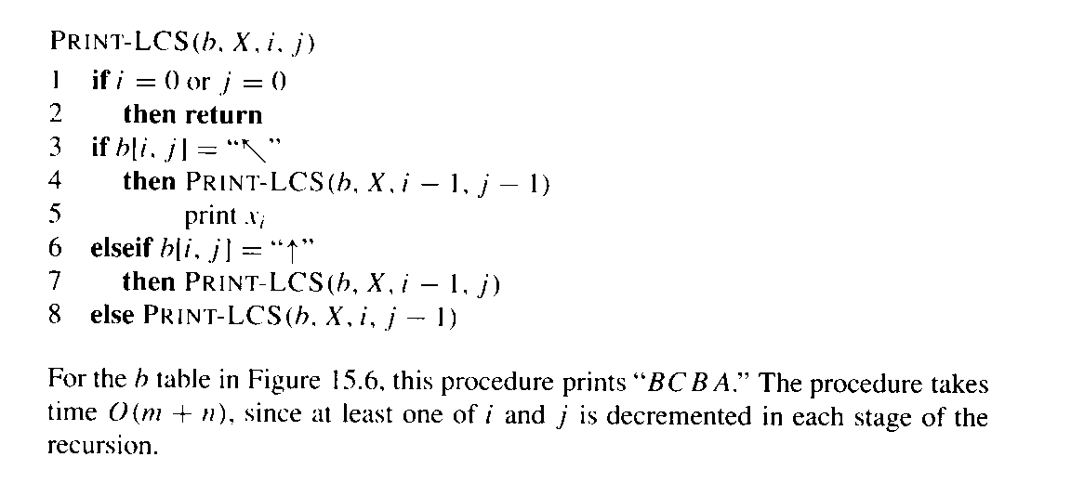
Example: LCS
Step 4: Construct an LCS
source: 91.503 textbook Cormen, et al.

Slide 12
Dynamic Programming
&
Greedy Algorithm
Activity Selection
Notes:
I joined the UMass Lowell Computer Science faculty this summer. This collection of slides is intended to familiarize the reader/viewer with my field of research (Computational Geometry), summarize my previous research results in this field and outline my plan for Computational Geometry research at UMass Lowell.

Slide 13
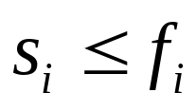
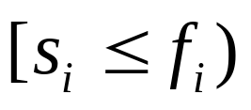
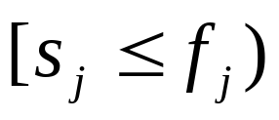
Activity Selection
Optimization Problem
Problem Instance:
  Set S = {1,2,...,n} of n activities
  Each activity i has:
    start time: s_{i}
    finish time: f_{i}
  Activities i, j are compatible iff non-overlapping:
  Objective:
    select a maximum-sized set of mutually compatible activities
source: 91.404 textbook Cormen, et al.

Slide 14
Activity Selection
Activity Time Duration
1
2
3
4
5
6
7
8
9
10
11
12
13
14
15
16
Activity Number
1
2
3
4
5
6
7
8

Slide 15
Activity Selection
Algorithmic Progression
“Brute-Force”
Dynamic Programming #1
  Exponential number of subproblems
Dynamic Programming #2
  Quadratic number of subproblems
Greedy Algorithm

Slide 16
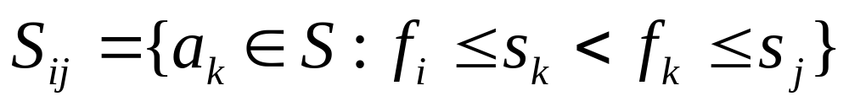
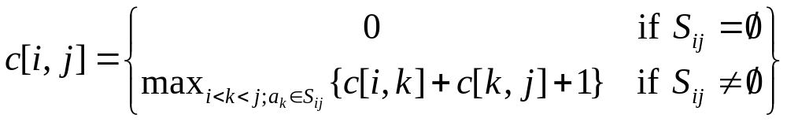
Activity Selection
Solution to S_{ij} including a_{k} produces 2 subproblems:
1) S_{ik} (start after a_{i} finishes; finish before a_{k} starts)
2) S_{kj} (start after a_{k} finishes; finish before a_{j} starts)
c[i,j]=size of maximum-size subset of mutually compatible activities in S_{ij}.
source: 91.404 textbook Cormen, et al.

Slide 17
Greedy Algorithm

Slide 18
What is a Greedy Algorithm?
Solves an optimization problem
Optimal Substructure:
  optimal solution contains in it optimal solutions to subproblems
Greedy Strategy:
  At each decision point, do what looks best “locally”
  Choice does not depend on evaluating potential future choices or presolving overlapping subproblems
  Top-down algorithmic structure
    With each step, reduce problem to a smaller problem
Greedy Choice Property:
  “locally best” = globally best

Slide 19
Greedy Strategy Approach
Determine the optimal substructure of the problem.
Develop a recursive solution.
Prove that, at any stage of the recursion, one of the optimal choices is the greedy choice.
Show that all but one of the subproblems caused by making the greedy choice are empty.
Develop a recursive greedy algorithm.
Convert it to an iterative algorithm.
source: 91.404 textbook Cormen, et al.

Slide 20
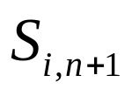

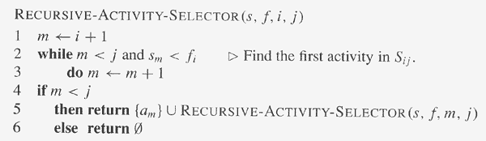

Recursive Greedy
Activity Selection
High-level call: RECURSIVE-ACTIVITY-SELECTOR(s,f,0,n)
Returns an optimal solution for
Errors from earlier printing are corrected in red.
source: web site accompanying 91.404 textbook Cormen, et al.

Slide 21
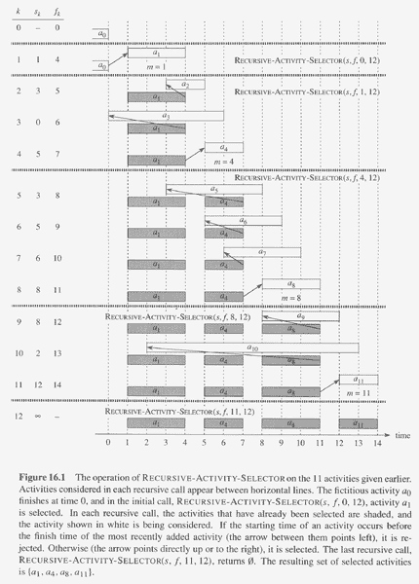
source: web site accompanying 91.404 textbook Cormen, et al.

Slide 22


Iterative Greedy
Activity Selection
source: 91.503 textbook Cormen, et al.
Iterative Greedy Algorithm:
  S’ = presort activities in S by nondecreasing finish time
    and renumber
  GREEDY-ACTIVITY-SELECTOR(S’)
    n length[S’]
    A {1}
    j 1
    for i 2 to n
        do if
        then
        j i
    return A
Running time?

Slide 23
Streamlined Greedy Strategy Approach
View optimization problem as one in which making choice leaves one subproblem to solve.
Prove there always exists an optimal solution that makes the greedy choice.
Show that greedy choice + optimal solution to subproblem optimal solution to problem.
Greedy Choice Property: “locally best” = globally best
source: 91.404 textbook Cormen, et al.

